Slide 1



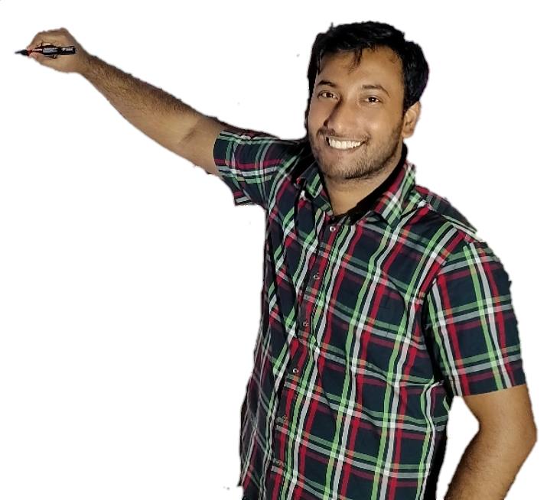
Week-12 (Discussion)
7th Oct, 2025
Computer Vision
Prof. Jayanta Mukhopadhyay
Professor
Computer Science and Engineering Department
IIT Kharagpur
Ayan Paul
PMRF Research Scholar
IIT Kharagpur

Slide 2
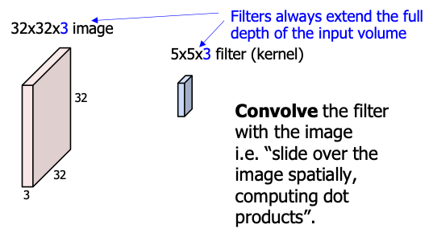
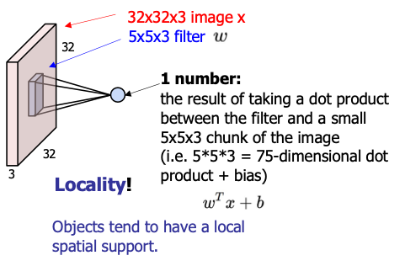
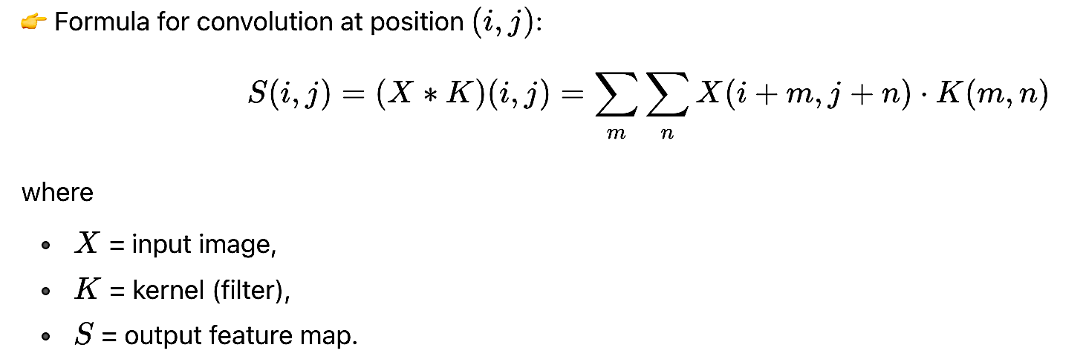
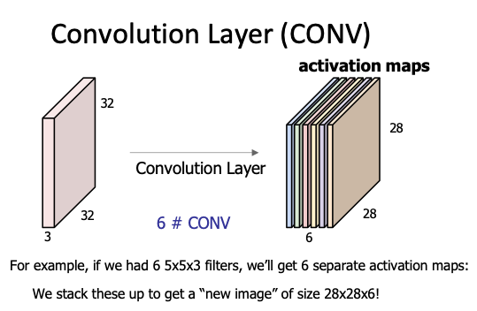
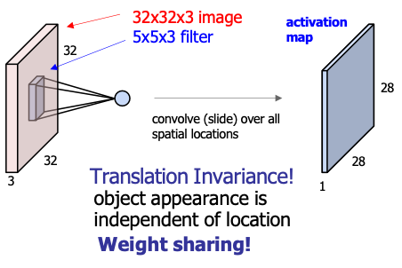
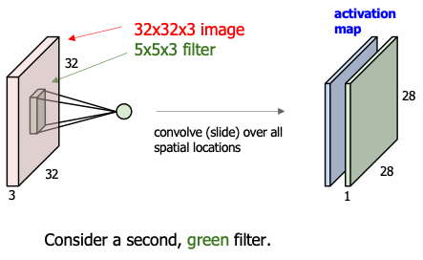
Convolution Layer
Purpose: Extract features (edges, textures, shapes, etc.) from the input image.
How it works:
A small matrix called a filter/kernel slides (convolves) over the image.
At each position, it performs an element-wise multiplication and sums the result → producing a feature map.
Different filters learn to detect different features (edges, corners, patterns).

Slide 3
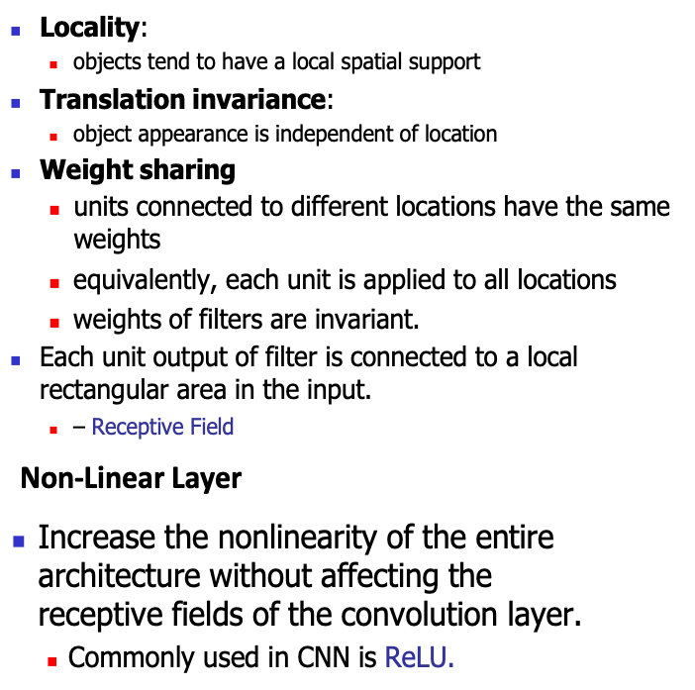
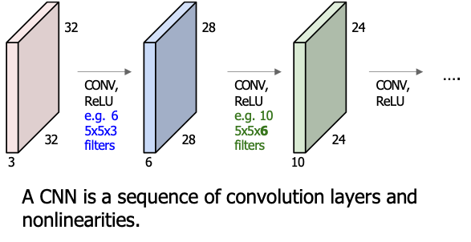
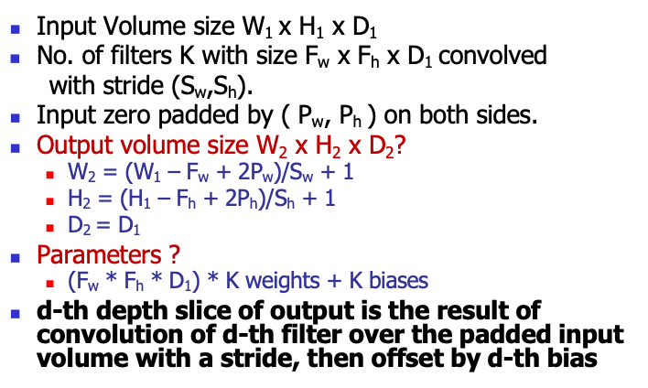
Features of CONV
Convolutional Neural Networks (CNN)
Parameters involved in the convolution layer

Slide 4
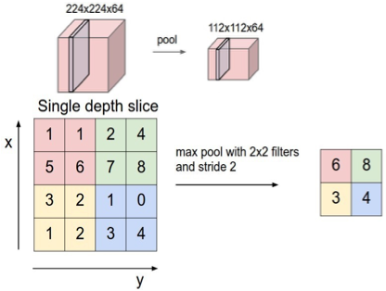
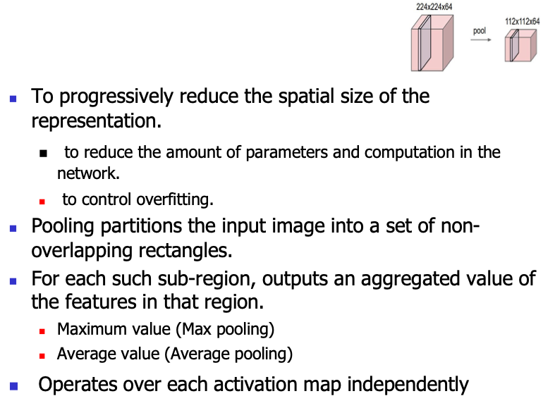
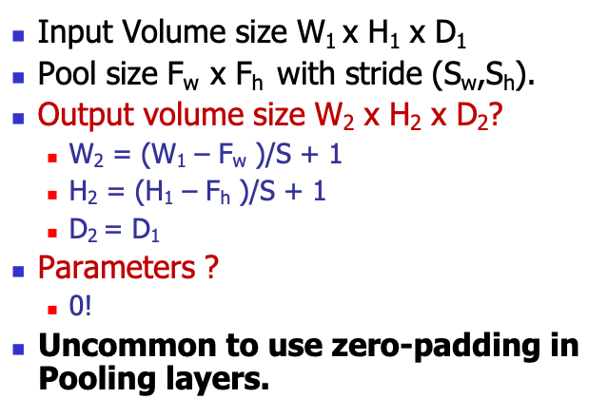
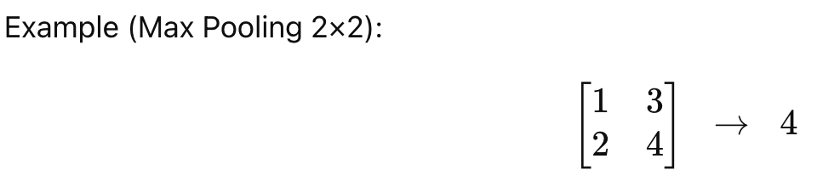
Pooling Layer (POOL)
Parameters involved in the pooling layer

Slide 5
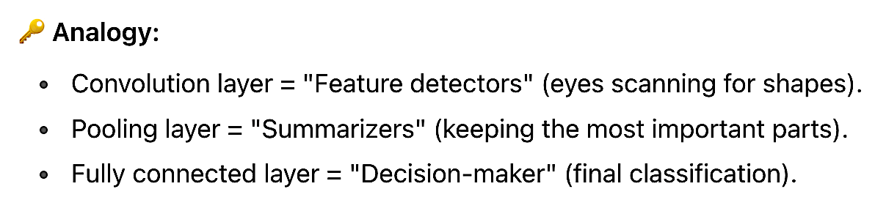
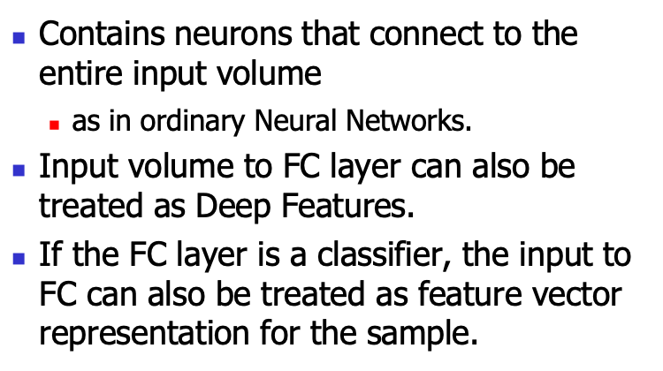
Fully Connected Layer (FC)
CNN Flow
Purpose: Make final decisions (classification/regression) after features are extracted.
How it works:
Flattens the feature maps into a 1D vector.
Each neuron is connected to every neuron in the next layer (like in a traditional neural network).
Learns to map high-level features → class scores (e.g., "dog", "cat").
Convolution Layers → Extract features.
Pooling Layers → Reduce dimension, keep strong features.
(Repeat convolution + pooling multiple times)
Fully Connected Layers → Use extracted features to classify the image.

Slide 6
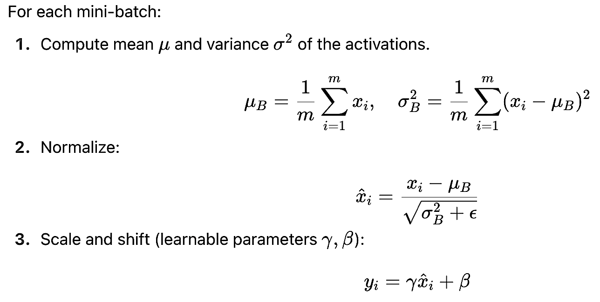
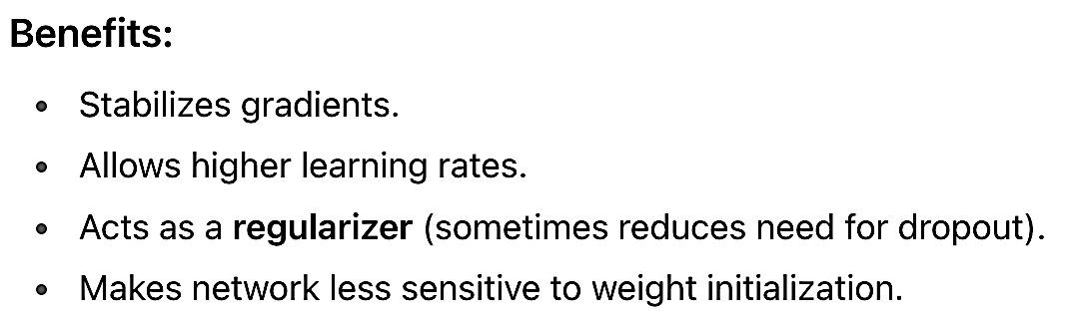
Batch Normalization
Purpose: Makes training faster, more stable, and less sensitive to initialization.
Why needed: During training, the distribution of activations in hidden layers keeps changing (called internal covariate shift). BN fixes this by normalizing.

Slide 7
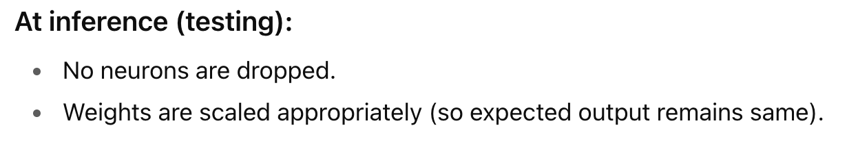
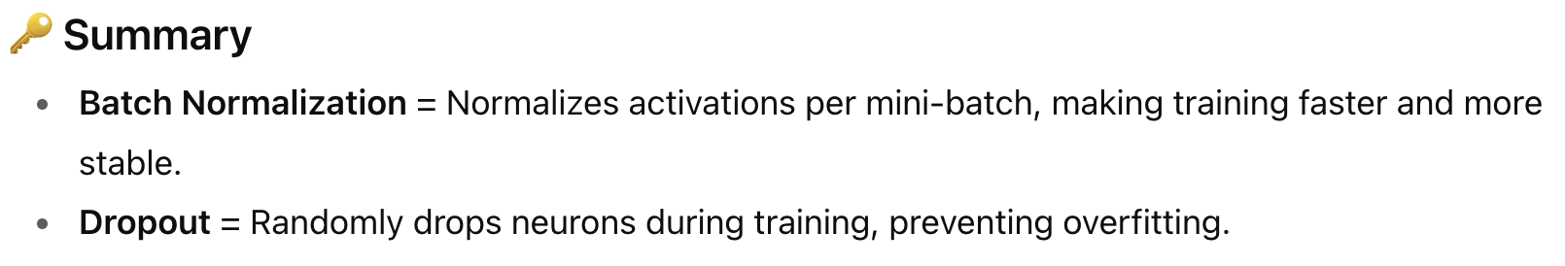
Drop out
Purpose: Prevents overfitting by forcing the network to not rely on specific neurons.
How it works:
During training, randomly "drop" (set to 0) a fraction of neurons with probability p.
This makes the network learn more robust, distributed representations.
Implementation
Retain output of a node with a probability p.
Typically within [0.5,1] at hidden layers and [0.8,1] in visible layers.

Slide 8
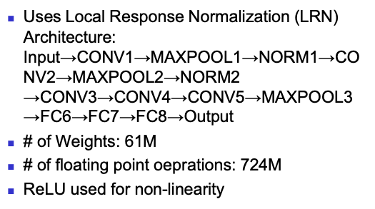
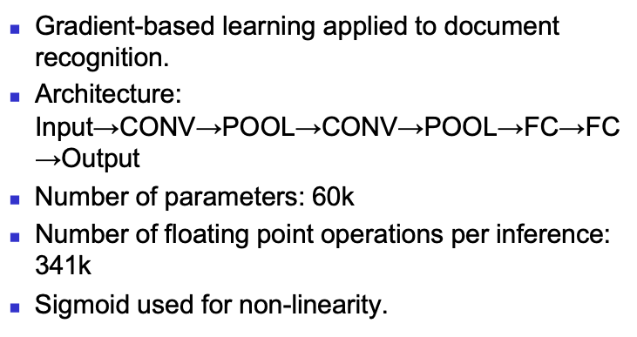
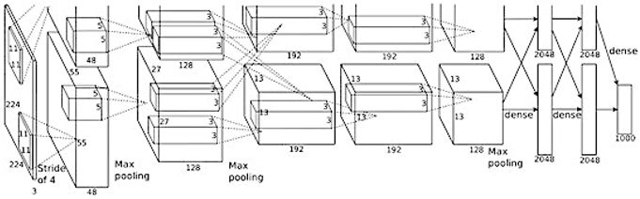
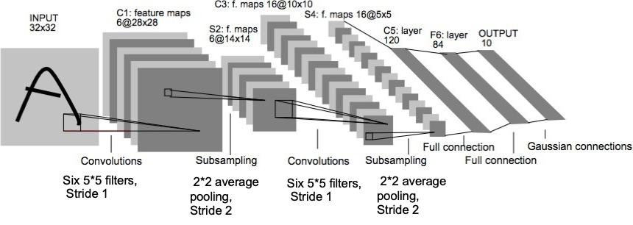
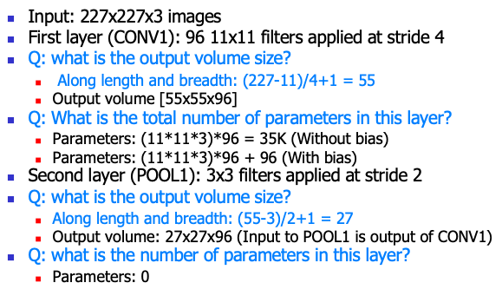
CNN Architectures
AlexNet
LeNet

Slide 9
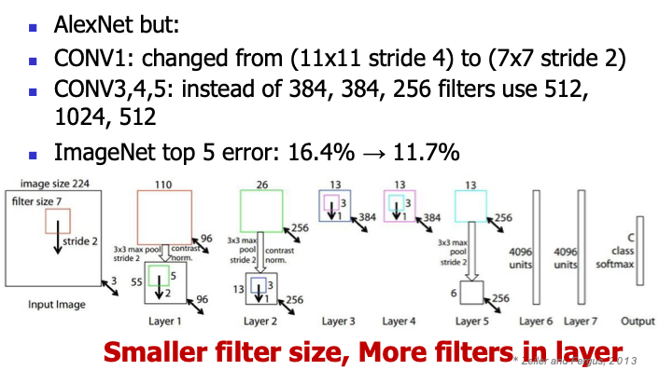
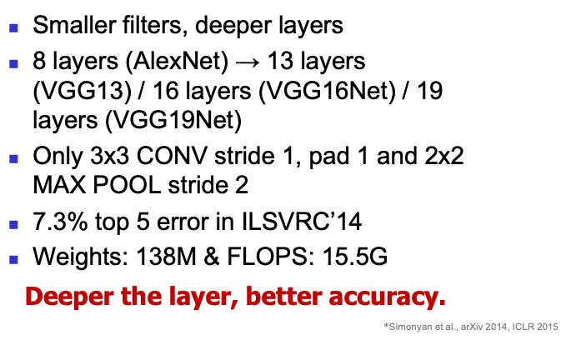
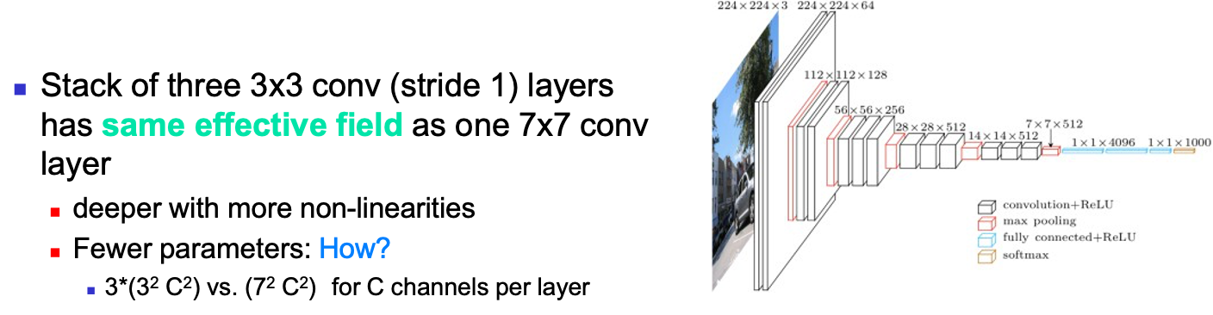
ZFNet
VGG

Slide 10
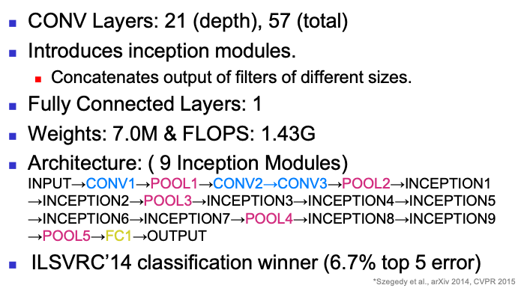
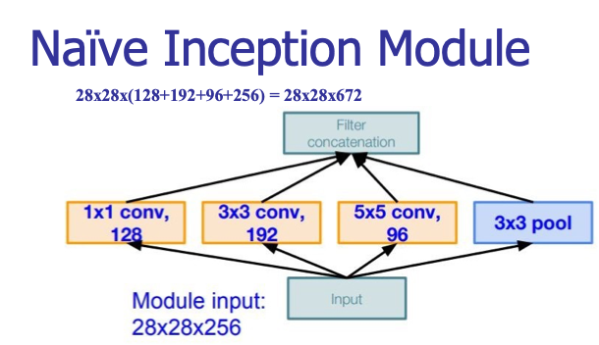
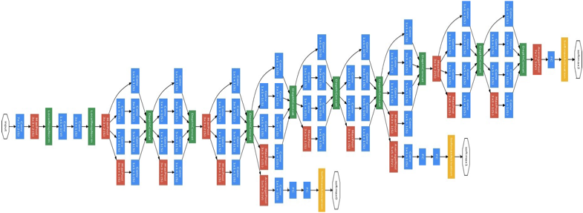
GoogleNet

Slide 11
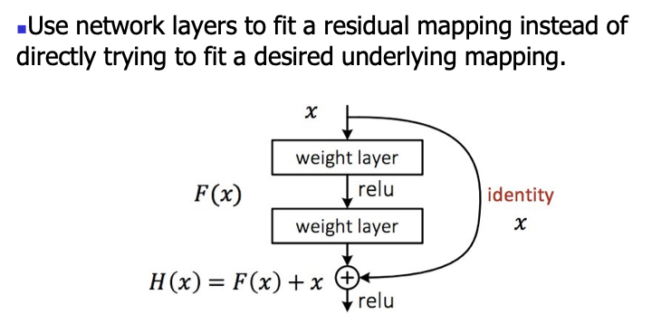
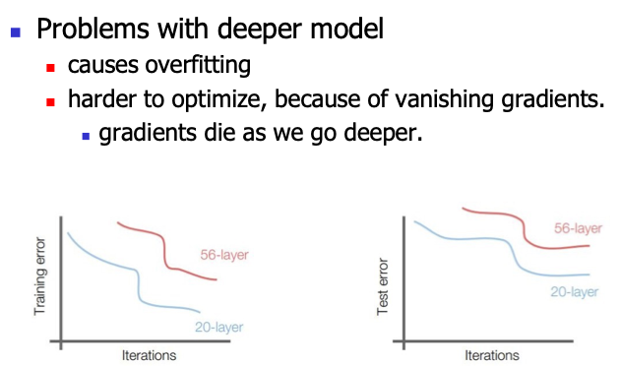
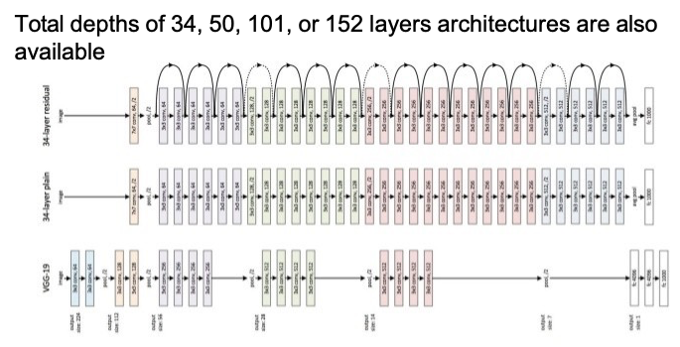
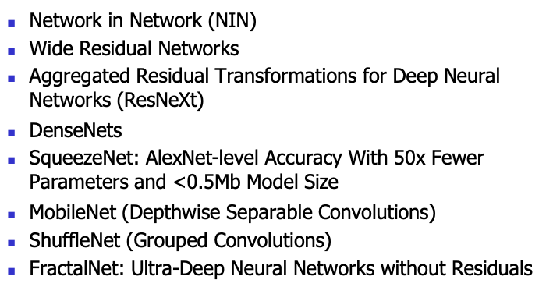
ResNet
Other Networks

Slide 12
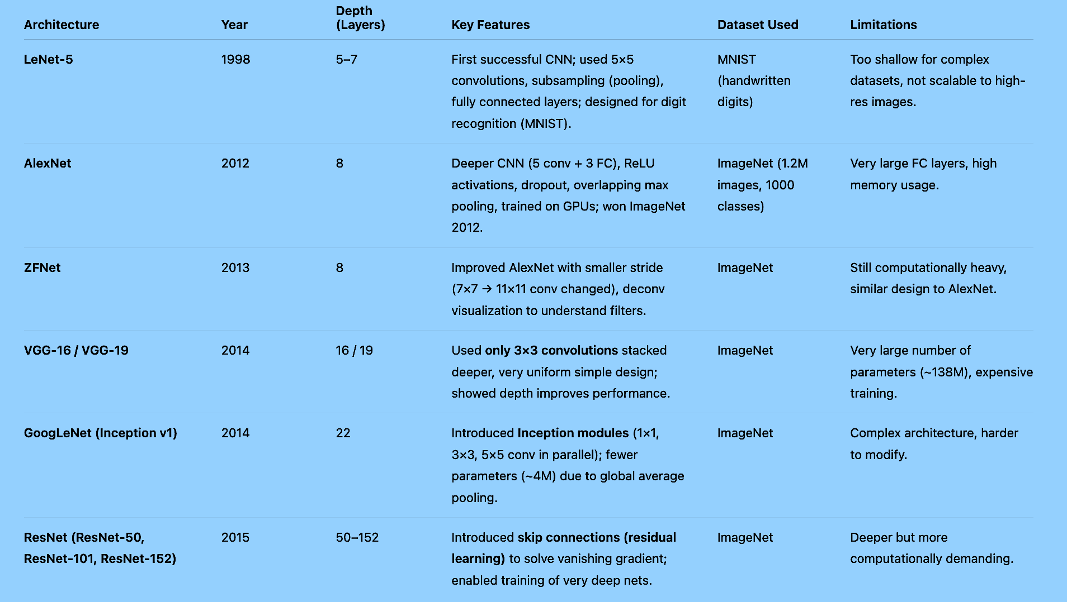
Comparison of CNN Architectures
Evolution Trend
LeNet → AlexNet: from shallow digit recognition to large-scale image classification.
AlexNet → ZFNet: improved hyperparameters + visualization.
ZFNet → VGG: deeper & simpler design using only small filters.
VGG → GoogLeNet: depth + efficiency using inception modules.
GoogLeNet → ResNet: solved vanishing gradient, enabling ultra-deep networks.

Slide 13
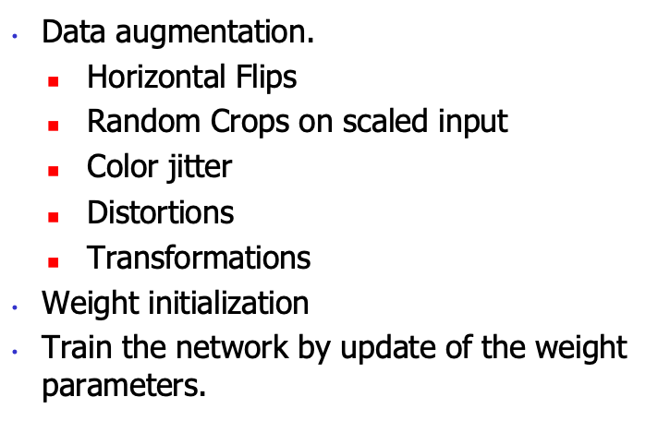
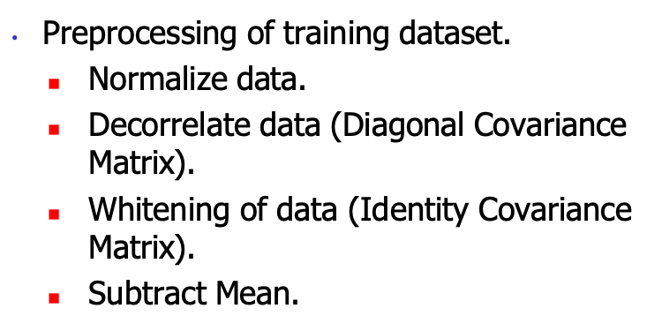
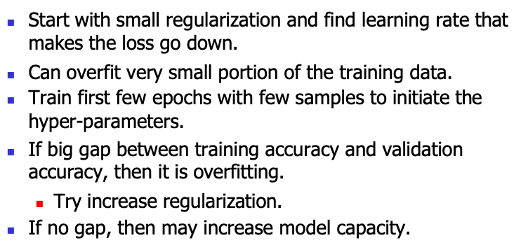
Training steps
Few Training Tips

Slide 14
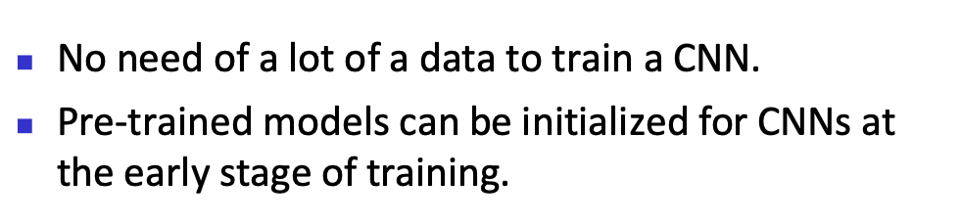
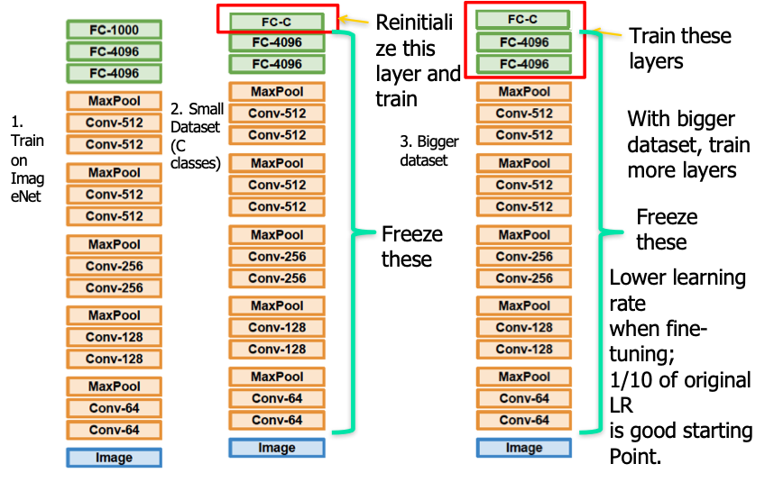
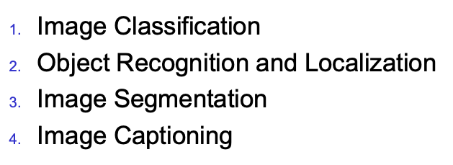
Transfer Learning
Applications of CNN

Slide 15
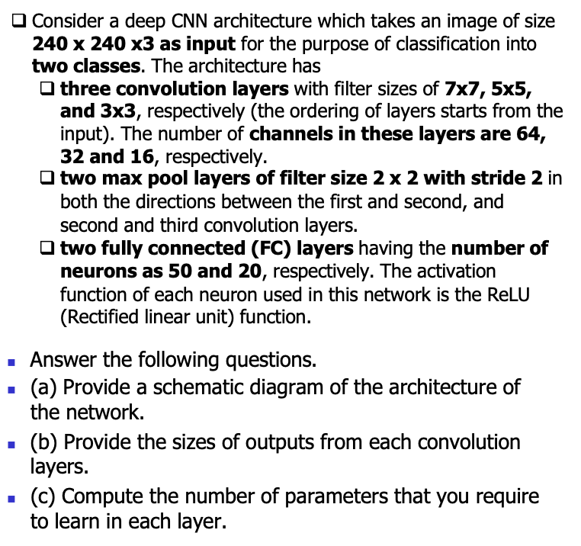
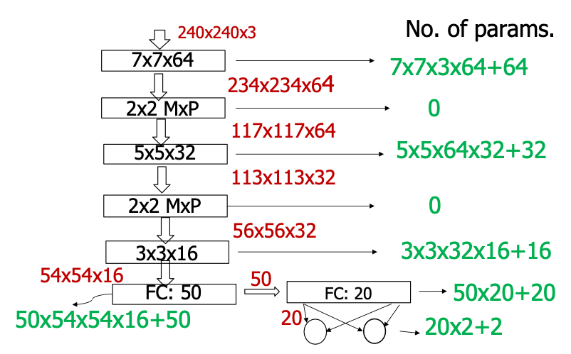
Exercise - 1
Solution

Slide 16
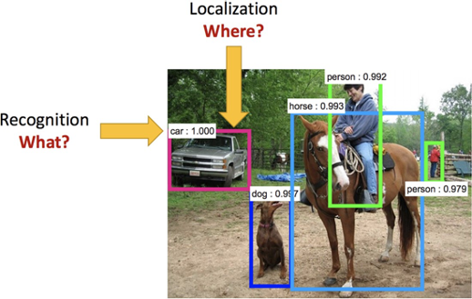
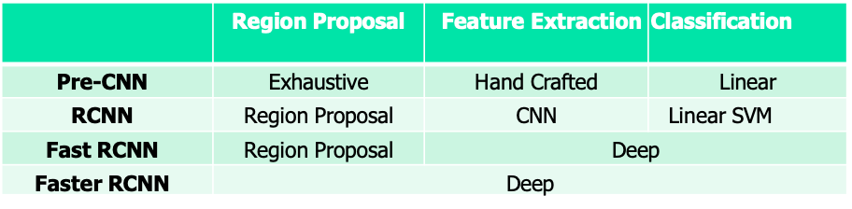
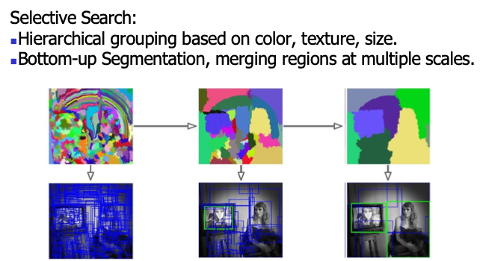
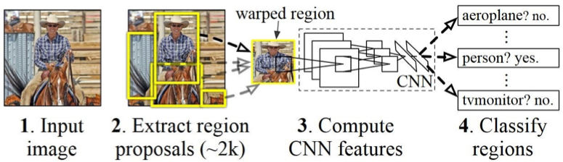
Object Recognition and Localization
RCNN
RCNN with CNN feature extractor
RCNN – Region Proposal

Slide 17
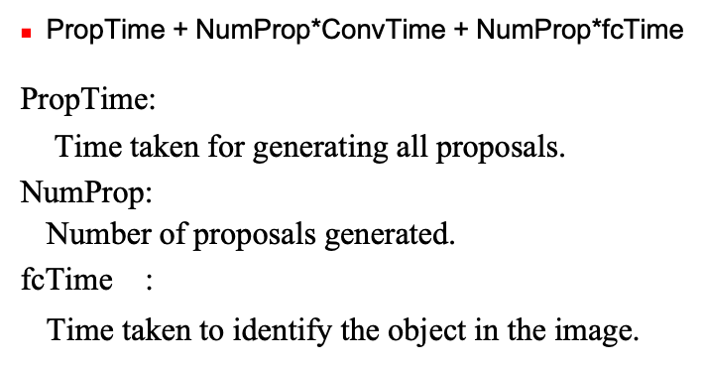
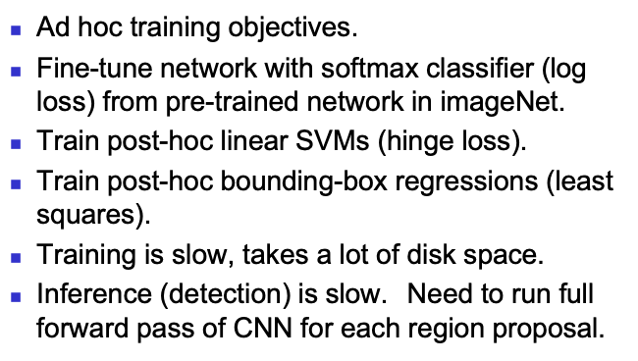


RCNN Problems
RCNN Inference Time
Fast RCNN

Slide 18



Fast RCNN Loss

Slide 19




Faster RCNN
Region Proposal Network
RPN Loss

Slide 20

Comparison of R-CNN, Fast R-CNN and Faster R-CNN
Evolution Trend
R-CNN (2014): Good accuracy but very slow (feature extraction for each region separately).
Fast R-CNN (2015): Shared feature maps + RoI pooling → faster, single-stage training.
Faster R-CNN (2015): Added RPN → proposals generated by CNN itself → major speed boost.
RPN (Region Proposal Network): The backbone of Faster R-CNN, enabling near end-to-end training.

Slide 21




Semantic Segmentation
Up-Sampling: Max Unpooling
Up-Sampling: Upconvolution

Slide 22




Convolution as matrix Multiplication
Exercise - 2
Solution

Slide 23





Exercise - 3
Solution
Semantic Segmentation
Semantic Segmentation (Encoder-Decoder)

Slide 24




Semantic Segmentation (Encoder-Decoder)
Semantic Segmentation (Decoder): Various options
U-Net architecture

Slide 25




Slide 26



Recurrent Neural Network
Recurrent Neural Networks: A few Applications
Unrolling of RNN

Slide 27



Recurrent Neural Network (Cont.)
CNN vs. RNN
Recurrent Neural Network: An example

Slide 28



Recurrent Neural Network: Types

Slide 29
Topics on which Week 12 Assignment Questions are based
Convolution Neural Network (CNN)
CNN Architectures – LeNet, AlexNet, ZFNet, VGG, GoogleNet, and ResNet
CNN for Detection – RCNN, Fast RCNN, and Faster RCNN
CNN for Semantic Segmentation – Unet
Recurrent Neural Network (RNN)

Slide 30

QUESTION 1
Which of the following statements are true for Pooling?
a) It is common to use zero padding in pooling layers.
b) It progressively reduces the spatial size.
c) It operates over each activation map independently.
d) It partitions the image into overlapping rectangles, taking the maximum (MaxPool) or
average (AvgPool) value from each of these sub-regions.
SOLUTION 1
CORRECT ANSWER 1
b), c), d)

Slide 31



QUESTION 2
Up-convolve the following input x using the filter h. What is the value at (2, 2) in the up-convolved feature map? We assume index of first cell of any 2D-matrix is (0,0).
Given: x(0, 0) = 1, x(0, 1) = 2, x(1, 0) = 3, x(1, 1) = 1.
h(0, 0) = 0, h(0, 1) = 1, h(0, 2) = 0, h(1, 0) = 2, h(1, 1) = 2, h(1, 2) = 1, h(2, 0) = 0, h(2, 1) =1, h(2, 2) = 0.
SOLUTION 2

Slide 32




CORRECT ANSWER 2
7

Slide 33


Slide 34




Slide 35


QUESTION 3
The softmax predictions of four different classes are [0.1 0.3 0.2 0.4]. Calculate the cross entropy loss for this sample (use natural logarithm) if the true labels are [0 0 0 1]. Round off the answer to 4 places of decimals.
SOLUTION 3
CORRECT ANSWER 3
0.9163

Slide 36


QUESTION 4
What is the main problem in stacking multiple layers to learn a large network with limited data?
a) over-fitting
b) high bias of the model
c) vanishing/exploding gradients
d) possibility of data augmentation
SOLUTION 4
CORRECT ANSWER 4
a), c)

Slide 37
Consider an input image of dimension 19 × 15 × 3. It passes through a convolutional layer with 64 kernels of dimension 5 × 5 × 3. The image has been zero padded on both sides with 1 × 1 padding and convolved using 2 × 2 stride.
Based on the given data solve the following questions 5, 6 and 7.

Slide 38


QUESTION 5
What is the dimension of the activation map?
a) 15 × 11 × 64
b) 15 × 11 × 3
c) 9 × 7 × 64
d) 9 × 7 × 3
SOLUTION 5
CORRECT ANSWER 5
c)

Slide 39


QUESTION 6
Calculate the number of parameters in the convolutional layer.
SOLUTION 6
CORRECT ANSWER 6
4864

Slide 40

QUESTION 7
Assume that the convolutional layer is followed by a MaxPool layer with kernel size 2 × 2.
Calculate the number of parameters in the pooling layer.
SOLUTION 7
CORRECT ANSWER 7
0

Slide 41

QUESTION 8
Consider a convolutional layer with input channel equal to 16. A kernel of size 3 × 3 is used to generate feature maps. The number of kernels used in this layer is 32. Calculate the number of parameters.
SOLUTION 8
CORRECT ANSWER 8
4640

Slide 42


QUESTION 9
Which of the following statements are true?
a) Fast-RCNN selects lesser number of region proposals from a given image compared to RCNN.
b) In Fast-RCNN, region proposals are prepared from the convolutional feature map of a given image.
c) RCNN computes CNN features on the whole input image.
d) Region proposal network (RPN) is trained to produce region proposals directly after the last convolutional layer in Faster-RCNN.
SOLUTION 9
CORRECT ANSWER 9
d)

Slide 43

QUESTION 10
In an object detection problem, the time taken to generate all proposals is 0.75. There are 4 number of proposals generated. What is the inference time of a Faster RCNN if the convolution time and the time taken by the fully connected layer are 2.25 and 1.75, respectively? Round off the answer to 2 places of decimals.
SOLUTION 10
CORRECT ANSWER 10
9.25

